Slide 1
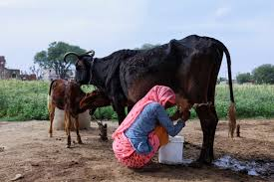

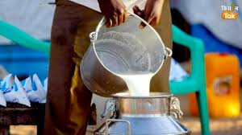
Attracting Cattle Herders towards Saras Dairy

Slide 2
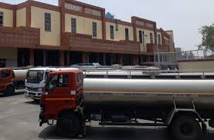
Business Problem
Low growth rates in the customer base
Milk transportation issues

Slide 3
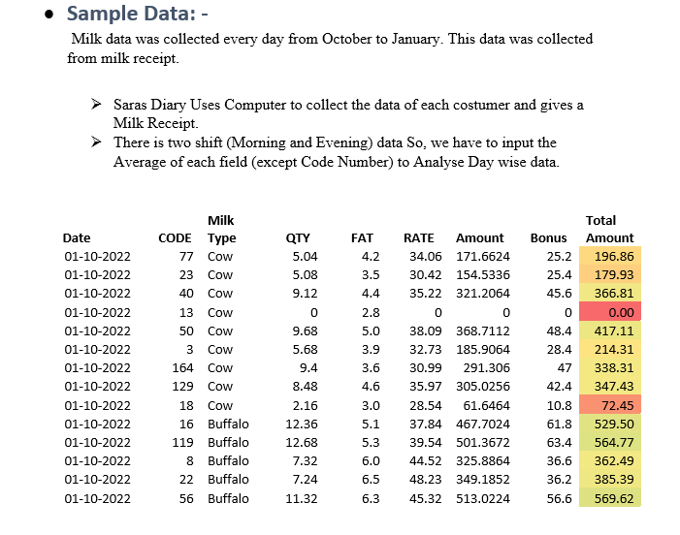
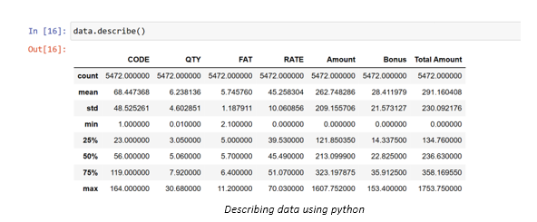
Data collection and pre-processing

Slide 4
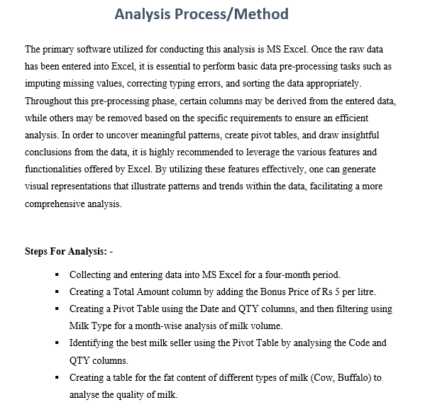
Data analysis methods

Slide 5
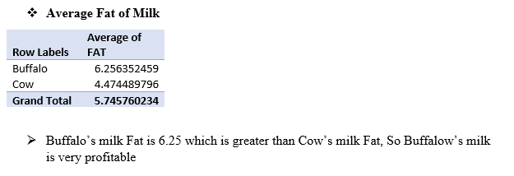
Key insights
One significant insight was the higher fat content in buffalo milk compared to cow milk. Based on this finding, I recommended motivating farmers to keep buffaloes for increased profitability.

Slide 6
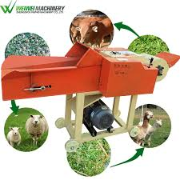
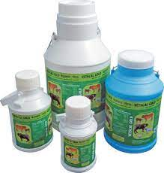
Additional services for customer base expansion
Offering extra services, such as grass cutting machines and nutritious products for animals.

Slide 7
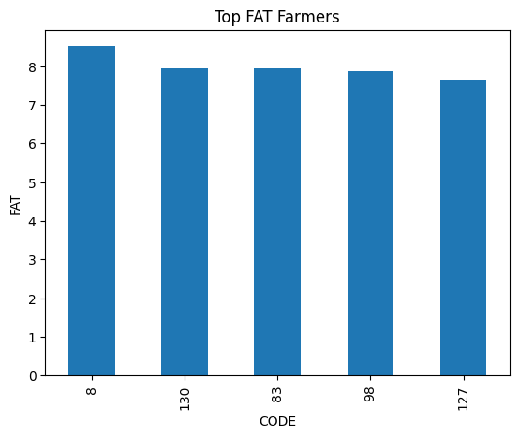
Top farmers
Farmers whose cattle give the top fat
- We can seek advice from these farmers, as it can be helpful for other farmers to increase fat in their cattle.

Slide 8
Transportation planning
Analyzing historical data, I developed a transportation plan, considering factors like festival seasons and their impact on milk volume. This ensured an efficient and optimized transportation system.

Slide 9
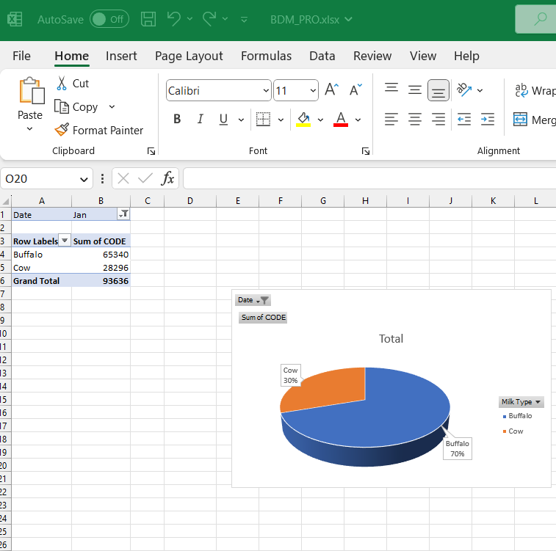
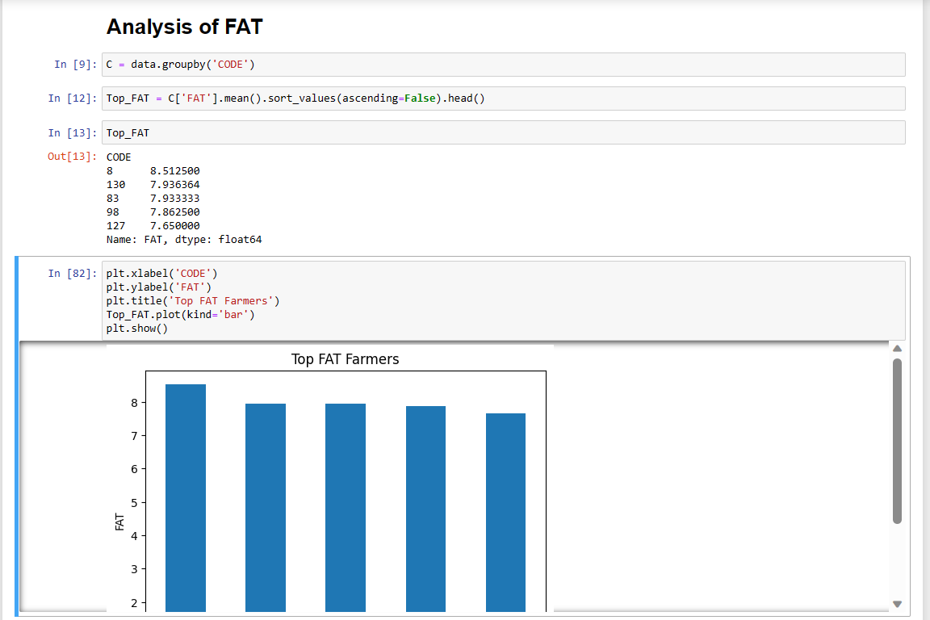
Tools for Analysis
Excel Python

Slide 10
Dashboard using PowerBI

